Slide 1
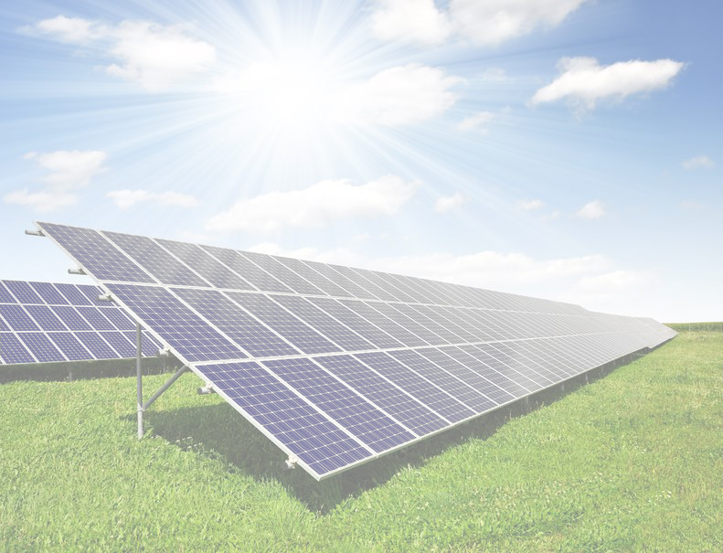
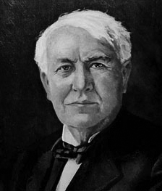
"I'd put my money on the sun and solar energy. What a source of power! I hope we don't have to wait until oil and coal run out before we tackle that.“
Solar Energy Boom or Bust?
A presentation by Solar Direct
— Thomas Edison, 1931

Slide 2
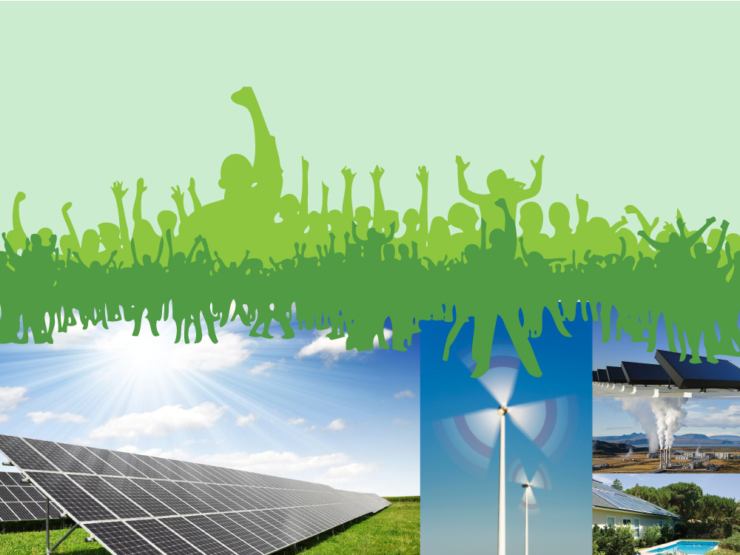
The Green Movement for an ecologically sustainable society
Notes:
The Green Movement

Slide 3
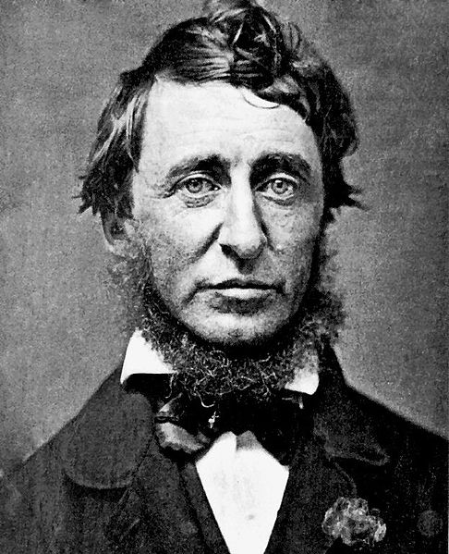
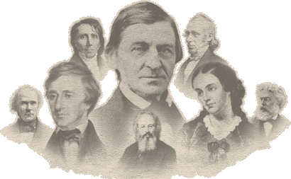
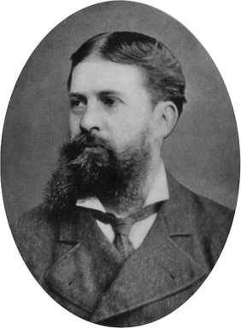
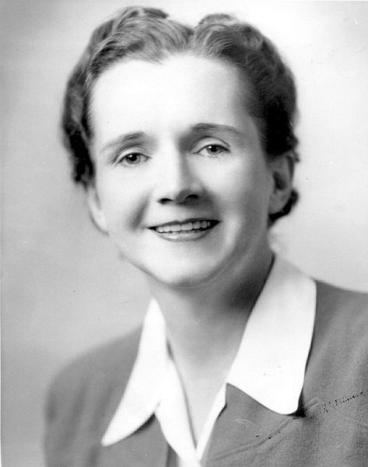
The Green Movement Beginnings
Transcendentalists
American Pragmatism
Henry David Thoreau 1817 – 1862
Rachel Carson
1907 – 1964
Notes:
The green movement as we think of it today has evolved considerably since the early days. While many people associate the beginning of the green movement with Rachel Carson’s breakthrough book Silent Spring and the legislative fervor of the 1970s, environmentalism is in fact rooted in the intellectual thought of the 1830s and 1840s. In fact, the “environmental movement” is a significant thread in the fabric of American philosophical thought – first developed by the Transcendentalists and most famously Henry David Thoreau, but tangibly expanded upon during the era of American pragmatism in the latter half of the 19th century. Environmentalism isn’t a trend, or a cult, or a form of hysteria. It is rooted in American philosophy and, being at once innovative and practical, idealistic and active, one could easily define modern environmentalism as quintessentially American.

Slide 4
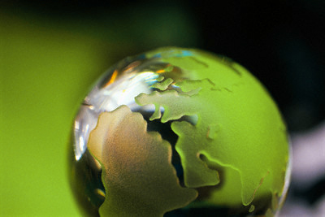
Environmentalism Today
Environmentalists advocate the sustainable management of resources and stewardship of the environment through changes in public policy and individual behavior. In its recognition of humanity as a participant in (not enemy of) ecosystems, the movement is centered on ecology, health, and human rights.
Notes:
Environmentalism in America today is defined as: “Environmentalists advocate the sustainable management of resources and stewardship of the environment through changes in public policy and individual behavior. In its recognition of humanity as a participant in (not enemy of) ecosystems, the movement is centered on ecology, health, and human rights.”

Slide 5
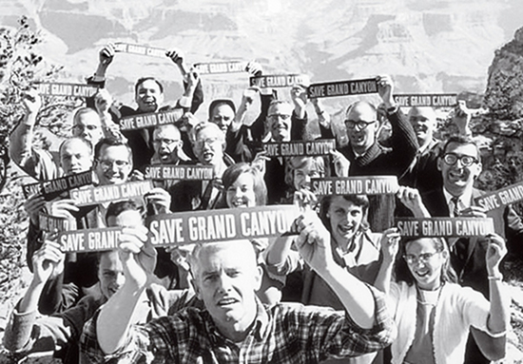
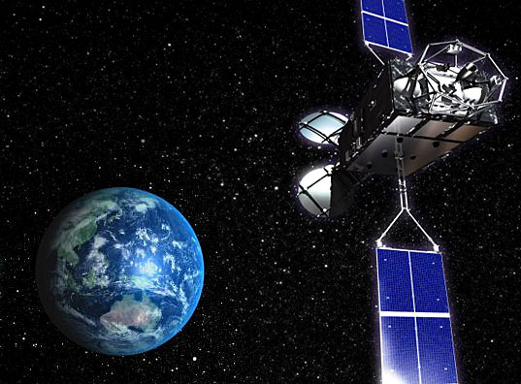
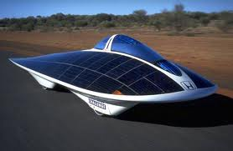
How did we get here?
Notes:
But how did we get from Thoreau and Teddy Roosevelt to “treehugging” and finally, the eco-friendly consumer-driven developments of today?

Slide 6
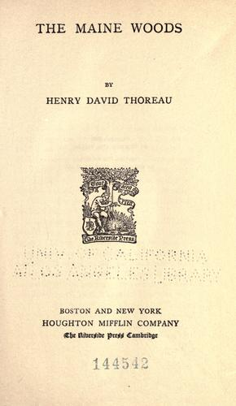
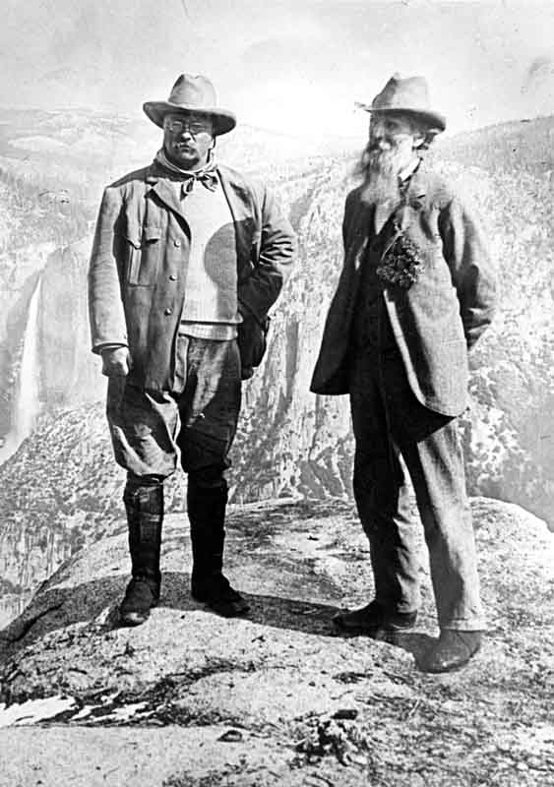
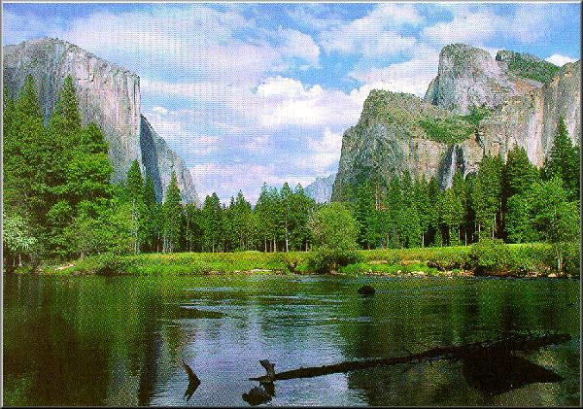
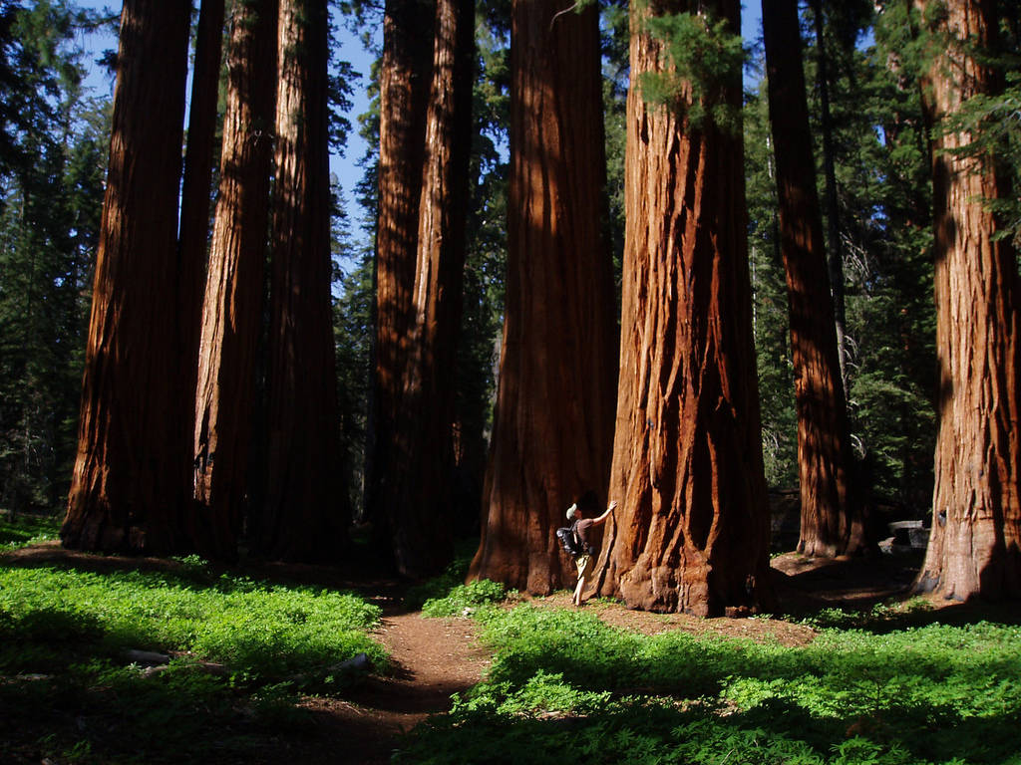
The Maine Woods
Henry David Thoreau
Theodore Roosevelt and John Muir
Sequoia Park
Yosemite National Park
Notes:
Rachel Carson certainly helped foster a reawakening of environmentalism, but it was Henry David Thoreau, in his book Maine Woods, who called for the conservation of and respect for nature and the federal preservation of virgin forests.
Beginning in the 1860s, the United States government saw fit to create parks and set aside wild lands for public good. Yosemite was claimed in 1864. It was made our first national park in 1872. The Audubon Society was founded in 1872 and Sequoia and General Grant parks were established.
Though the federal government had begun taking actions to preserve lands, it was Teddy Roosevelt and John Muir – a bit of an unlikely pair – who publicized and popularized conservation. Teddy’s visit to Yosemite in 1903 gained national publicity. By 1916 the National Park Service had been established with leadership by Stephen Mather.

Slide 7
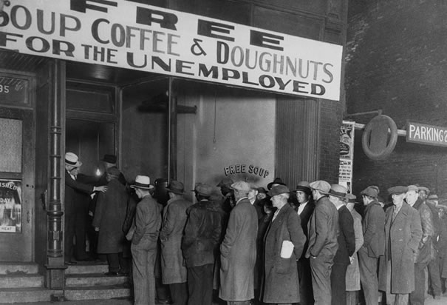
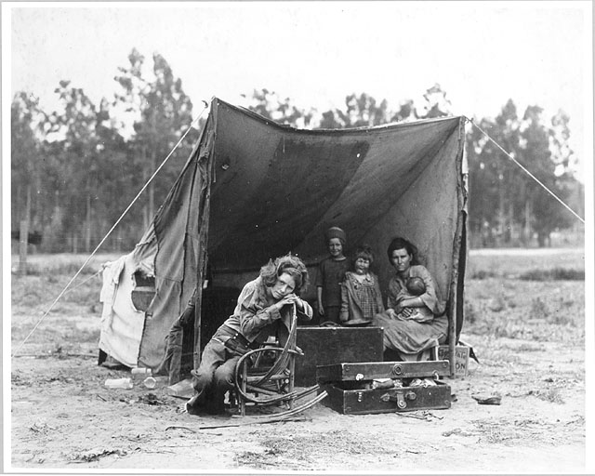
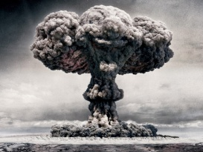
Notes:
# 5 -- But just as swiftly, the World Wars – sandwiching the traumatic Great Depression – forced environmental concerns to the background of public thought. While the Sierra Club continued to grow rapidly and became instrumental in establishing many parks during these years, environmentalism as we know it today was not a concern for most Americans – or, consequently, the federal government.

Slide 8
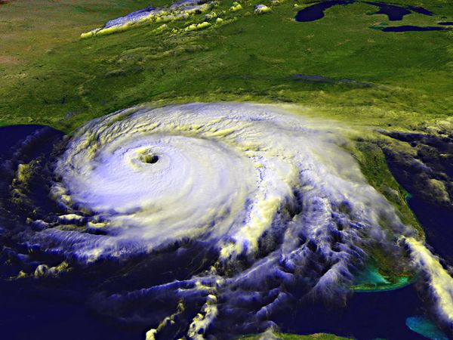
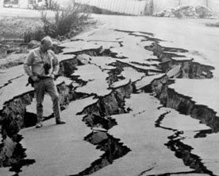
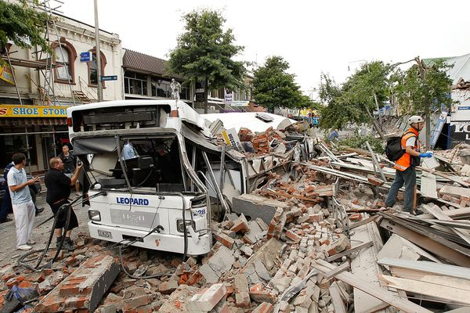
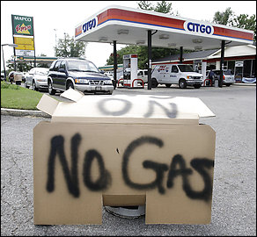
Notes:
# 6 -- Sobering international events, catastrophic weather, visible climate change, war, gas shortages and scientific consensus legitimized environmental concerns during the early years of the new century.

Slide 9
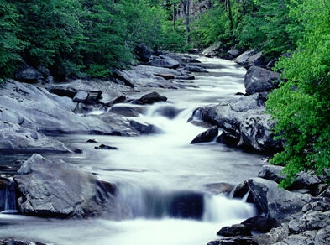
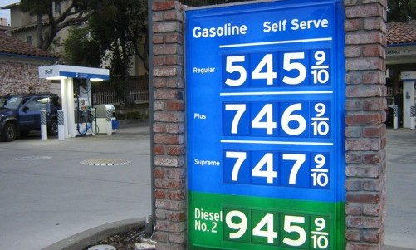
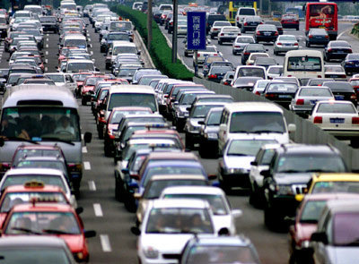
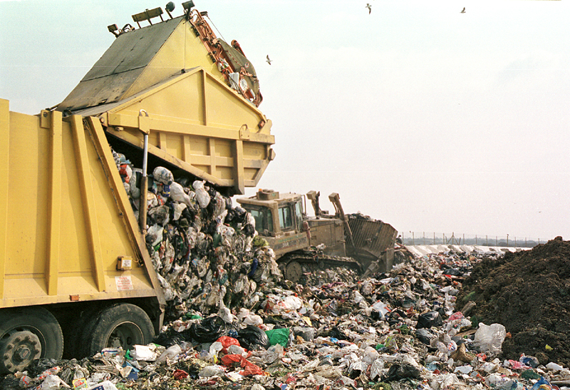
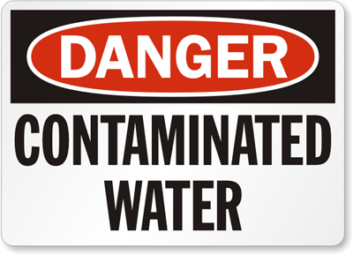
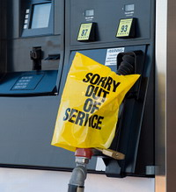
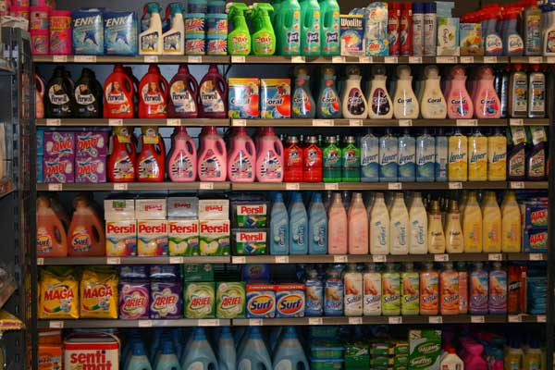
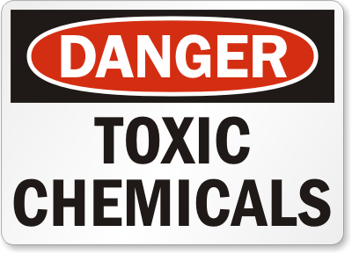
Notes:
#7 --- Suddenly, the problems were obvious everywhere you looked: our food was chemically treated and genetically modified, our water was contaminated with toxic chemicals, our resources were running out, our wasteful habits were filling landfills, and gas prices were soaring – to name but a few key issues that have spurred millions to “go green”.

Slide 10
History of Solar
Milestones in the historical development of solar technology
Notes:
#8 -- History of Solar Energy

Slide 11
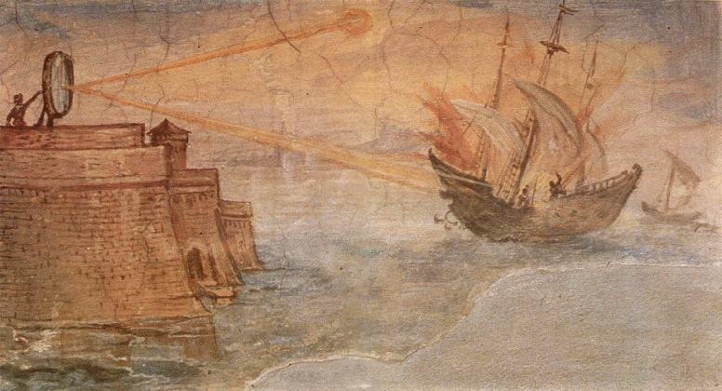
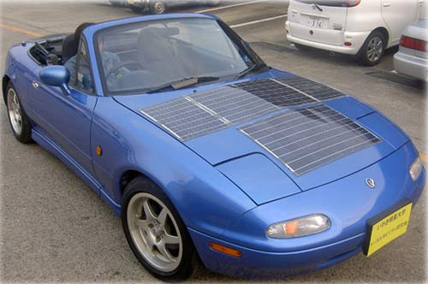
7th Century B.C
Today
Solar technology isn’t new
Notes:
8A -- Solar technology isn’t new. Its history spans from the 7th Century B.C. to today. We started out concentrating the sun’s heat with glass and mirrors to light fires. Today, we have everything from solar-powered buildings to solar powered vehicles.

Slide 12
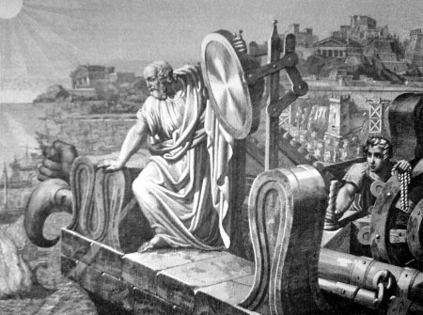
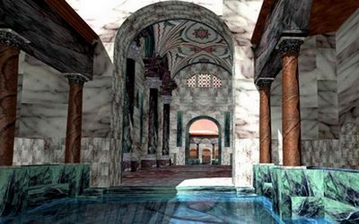
Roman bathhouses
Greek Scientist Archimedes
212 BC
Notes:
# 9 -- As early as 212 BC, the Greek scientist, Archimedes, used the reflective properties of bronze shields to focus sunlight and to set fire to wooden ships from the Roman Empire which were besieging Syracuse.
The famous Roman bathhouses in the first to fourth centuries A.D. had large south facing windows to let in the sun’s warmth.

Slide 13
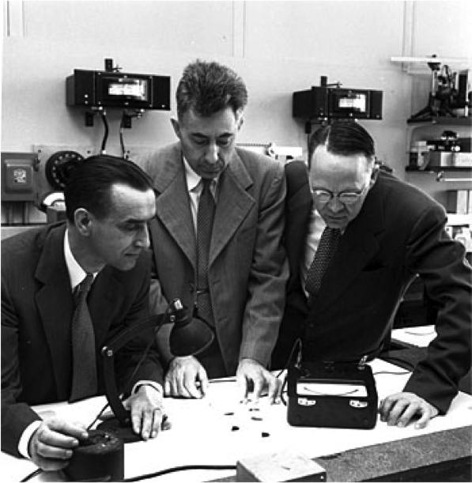
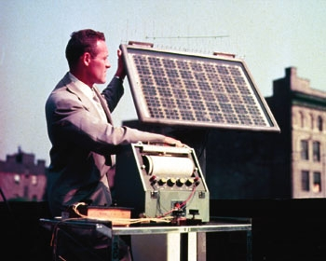
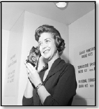
In 1954 Daryl Chapin, Calvin Fuller, and Gerald Pearson develop the silicon photovoltaic (PV) cell at Bell Labs
Western Electric began to sell commercial licenses for silicon photovoltaic technologies like the solar powered radio above
Bell Telephone Laboratories produced a silicon solar cell with 4% efficiency and later achieved 11% efficiency.
Notes:
10 -- Fast forward to 1954. Photovoltaic technology is born in the United States when Daryl Chapin, Calvin Fuller, and Gerald Pearson develop the silicon photovoltaic (PV) cell at Bell Labs—the first solar cell capable of converting enough of the sun’s energy into power to run everyday electrical equipment. Bell Telephone Laboratories produced a silicon solar cell with 4% efficiency and later achieved 11% efficiency. Later that year, Western Electric began to sell commercial licenses for silicon photovoltaic technologies.

Slide 14
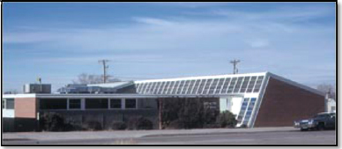
The world’s first commercial office building using solar water heating and passive design
Architect Frank Bridgers designed the world’s first commercial office building using solar water heating and passive design. This solar system has been continuously operating since that time and the Bridgers-Paxton Building, is now in the National Historic Register as the world’s first solar heated office building.
Notes:
11 -- Soon thereafter, Architect Frank Bridgers designed the world’s first commercial office building using solar water heating and passive design. This solar system has been continuously operating since that time and the Bridgers-Paxton Building, is now in the National Historic Register as the world’s first solar heated office building.

Slide 15
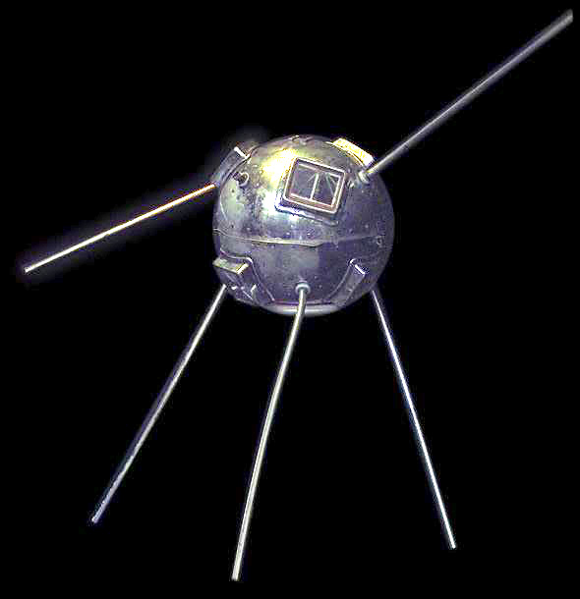
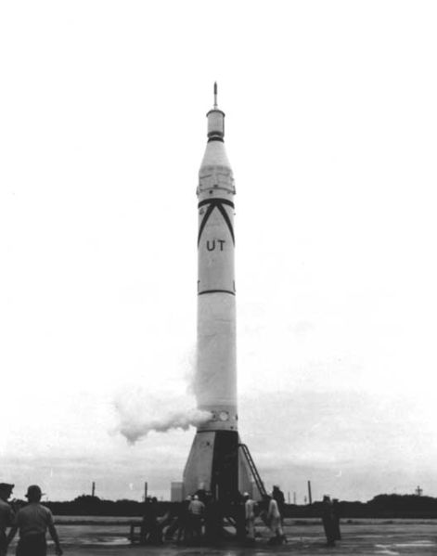
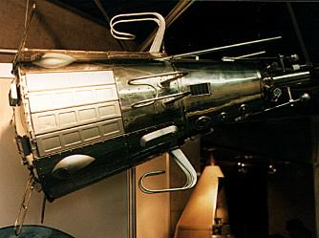
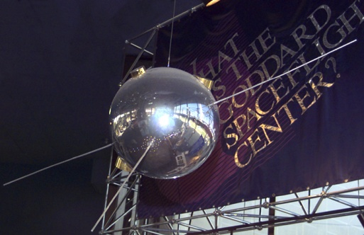
Photovoltaic cells for orbiting earth satellites.
Vanguard I space satellite
Explorer III
Vanguard II
Sputnik 3
Notes:
12 -- William Cherry of U.S. Signal Corps Laboratories, approaches RCA Labs’ about developing photovoltaic cells for proposed orbiting Earth satellites. That technology was then used on the Vanguard I space satellite which used a small (less than one watt) array to power its radios. Later that year, Explorer III, Vanguard II, and Sputnik-3 were launched with PV-powered systems on board. Despite faltering attempts to commercialize the silicon solar cell in the 1950s and 60s, it was used successfully in powering satellites. It became the accepted energy source for space applications and remains so today.

Slide 16
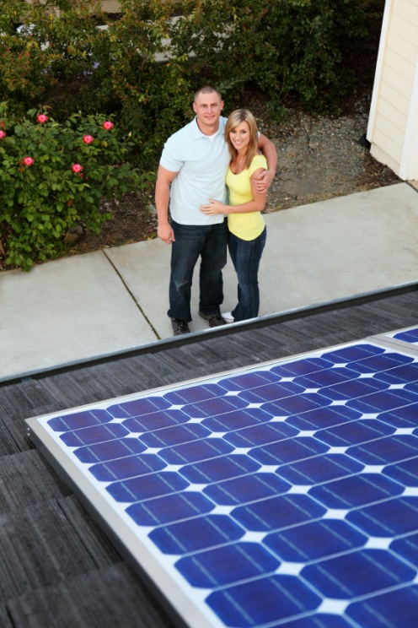
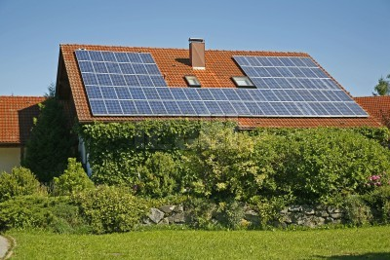
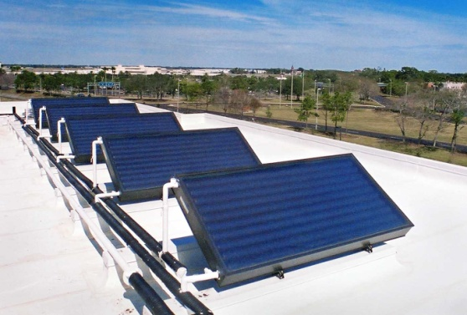
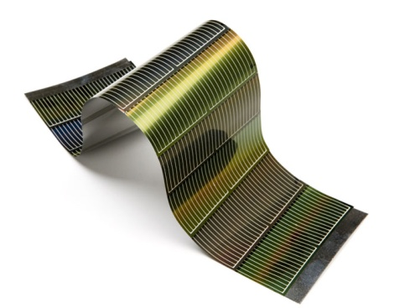
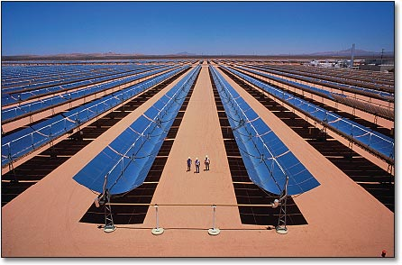
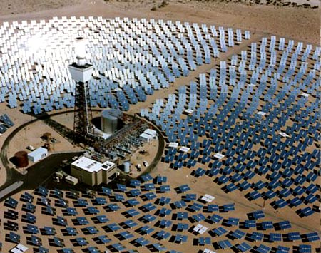
The technology has also evolved significantly.
Notes:
13 -- The technology has also evolved significantly. Within a few decades, we have come from simple solutions to complex developments in solar technology. Technology roadmaps for the future outline the research and development path to full competitiveness of concentrating solar power with conventional power generation technologies. Concentrating solar power, or solar thermal electricity, could harness the sun’s heat energy to provide large-scale, domestically secure, and environmentally friendly electricity.
Photovoltaics research and development will continue with an intense interest in new materials, cell designs, and novel approaches to solar material and product development. It is a future that shines bright.
Shom??? Modern modules, cells, thin film, residential systems, water heating systems, large scale concentrating system

Slide 17
Types of Solar Energy:
Thermal (Heat)
Photovoltaic (Electric)
Notes:
14 –Types of Solar Energy: Thermal (Heat) & Photovoltaic ( Electric)

Slide 18
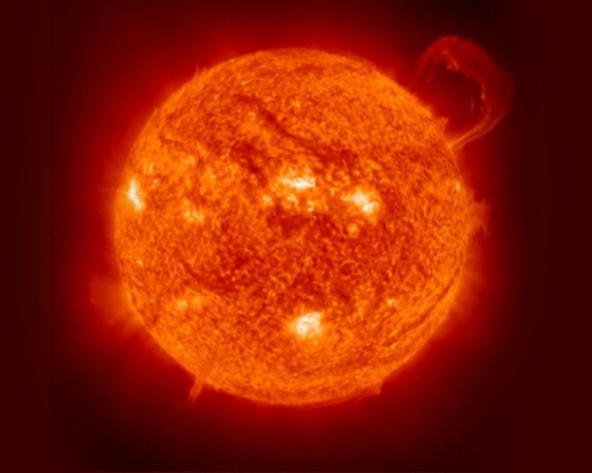
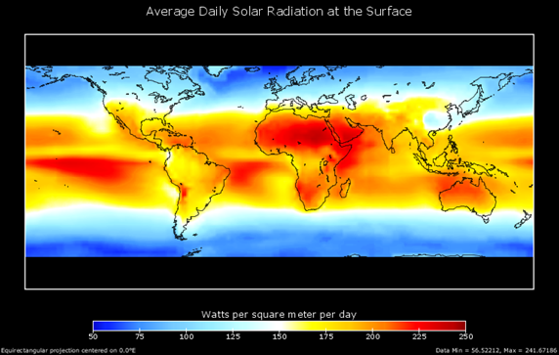
Solar Radiation
Notes:
15 -- Solar radiation, often called the solar resource, is a general term for the electromagnetic radiation emitted by the sun. Solar radiation can be captured and turned into useful forms of energy, such as heat and electricity, using a variety of technologies.

Slide 19
Thermal Energy
PASSIVE SYSTEMS
Rely on heat-driven convection or heat pipes to circulate water or heating fluid in the system. No moving parts
ACTIVE SYSTEMS
Use one or more pumps to circulate water and/or heating fluid in the system.
Direct /open loop circulate potable water through the collectors
Indirect/closed loop use a heat exchanger that separates the potable water from the heat transfer fluid that circulates through the collectors
Notes:
16 – Thermal Energy
17 -- There are two types of solar thermal systems: passive and active, (air and liquid?) A passive system requires no equipment, like when heat builds up inside your car when it's left parked in the sun. An active system requires some way to absorb and collect solar radiation and then store it.

Slide 20
Direct systems: (A) Passive CHS system with tank above collector. (B) Active system with pump and controller driven by a photovoltaic panel
Notes:
I added this extra slide

Slide 21
Indirect active systems: (C) Indirect system with heat exchanger in tank (D) Drainback system with drainback reservoir. In these schematics the controller and pump are driven by mains electricity
Notes:
I added this extra slide

Slide 22
Solar Thermal – Types of Collectors
Low Temp.
Flat Plate
Pool
Med Temp.
Flat Plate
Domestic Water
Med Temp.
Flat Plate
Pool/Water/Air
High temperature
Evacuated tubes
Many applications including: Water, Space and Process Heating
High Temperature
Concentrating
XXXXXX
XXXXXXXXXX
Notes:
18 – types of collectors
There are different types of collectors. Low-temperature collectors are flat plates generally used to heat swimming pools. They are often simple devices which allow for the exposure to the sun for the sole purpose of heating. They are generally made of heavy-duty rubber or plastic treated with an ultraviolet (UV) light inhibitor to extend the life of the panels. Because of their inexpensive parts and simple design, these types of collectors are usually less expensive than active collectors.
Medium-temperature collectors are also usually flat plates but are used for heating water or air for residential and commercial use. They feature one or more black tanks or tubes in an insulated, glazed box. Cold water first passes through the solar collector, which preheats the water. The water then continues on to the conventional backup water heater, providing a reliable source of hot water.
High Temperature, Evacuated Tube & Concentrating

Slide 23
Types of Systems
Water Heating – Flat Plate
Water /Space Heating – Evacuated Tubes
Pool Heating
Notes:
19 – Types of Systems:
Space Heating – SPH – SWH Flat plate – SWH Evacuated Plate

Slide 24
Solar Thermal – Applications
Space Heating and Cooling
Domestic Water Heating
Swimming Pool Water Heating
Commercial and Utility Power Generation
Notes:
20 – Applications: Space Heating and Cooling, Water Heating for pools, homes, commercial and utility power generation
In the United States, heating, ventilation, and air conditioning (HVAC) systems account for over 25 percent of the energy used in commercial buildings and nearly half of the energy used in residential buildings. Solar heating, cooling, and ventilation technologies can be used to offset a portion of this energy.
Solar thermal systems are a promising renewable energy solution - the sun is an abundant resource. Except when it's nighttime. Or when the sun is blocked by cloud cover.

Slide 25
Solar Pool Heating Residential

Slide 26
Solar Pool Heating Commercial
Notes:
Wauchula County High School

Slide 27
Solar Water Heating Residential

Slide 28
Solar Water Heating Commercial
Notes:
Moorings Park

Slide 29
Solar Space Heating Residential

Slide 30
Solar Space Heating Commercial
Notes:
Evacuated Tube Collectors: Water Heating, Space Heating, Commercial Projects, Extreme Weather

Slide 31
Solar Pool Panels System Layout

Slide 32
Solar Domestic Hot Water Passive System Layout
Notes:
Passive systems have no moving parts, excellent for all climate regions except extreme cold – Best choice for Florida: most economical and efficient

Slide 33
Solar Domestic Hot Water - Active System Layout
Notes:
Flat plate collectors can also be used for pool heating in extreme cold weather. SDHW ACTIVE systems have moving parts

Slide 34
Space Heating System Layout
Notes:
Space Heating -- Evacuated Tube Collectors – There are other types of collectors for space heating. Evacuated Tube collectors can also be used for water heating and commercial applications

Slide 35
Photovoltaic Energy (PV)
Notes:
21 – Photovoltaic Energy - PV

Slide 36
Where does our electricity comes from?
Notes:
22 -- Most of us don't think much about where our electricity comes from, only that it's available and plentiful. Electricity is typically generated by burning fossil fuels such as coal, oil and natural gas, and emits carbon dioxide, nitrogen oxides and sulfur oxides gases which scientists believe contribute to climate change.

Slide 37
How does PV Work?
Notes:
23 – How do they work 24 -- types
Solar Panels for electricity consist of solar cells which are made from semiconductor materials. Photovoltaics (PV) is a method of generating electrical power by converting solar radiation into direct current electricity using semiconductors that exhibit the photovoltaic effect. Photovoltaic power generation employs solar panels composed of a number of solar cells containing a photovoltaic material. Materials presently used for photovoltaics include monocrystalline silicon, polycrystalline silicon, amorphous silicon, cadmium telluride, and copper indium gallium selenide/sulfide.

Slide 38
PV Modules (Panel) Types
Monocrystalline silicon
Polycrystalline silicon
Amorphous silicon
Cadmium telluride
Copper indium gallium selenide/sulfide
Notes:
23 – How do they work 24 -- types
Solar Panels for electricity consist of solar cells which are made from semiconductor materials. Photovoltaics (PV) is a method of generating electrical power by converting solar radiation into direct current electricity using semiconductors that exhibit the photovoltaic effect. Photovoltaic power generation employs solar panels composed of a number of solar cells containing a photovoltaic material. Materials presently used for photovoltaics include monocrystalline silicon, polycrystalline silicon, amorphous silicon, cadmium telluride, and copper indium gallium selenide/sulfide.

Slide 39
Notes:
25 -- The basic solar cell typically produces only a small amount of power. To produce more power, solar cells can be interconnected to form panels or modules. PV modules range in output from 10 to 300 watts. About 10–20 PV arrays can provide enough power for a household. PV systems are modular, depending on your electricity use every part of the system can be scaled to provide as much power as you want.
PIC MODULE & HOME SYSTEM ARRAY

Slide 40
Grid-Connected System
Notes:
26 -- Grid-Connected Solar PV systems can connect with the existing power grid and could sell excessive electricity back to the utility with a plan known as Net Metering. An optional battery can store power for use when the system is not producing electricity such as during the night or during blackouts.
(put a diagram of a basic system from module to meter)

Slide 41
Grid-Connected System
Notes:
Kirk , this is a duplicate the slide above for you to choose which diagram you like best – I like this one from the eere department but it’s not in color

Slide 43
Off-Grid System
Notes:
27 – Off-Grid Solar PV systems are designed to operate independent of the electric utility grid, and are generally designed and sized to supply certain DC and/or AC electrical loads.
(put a picture off-grid system with batteries)

Slide 44
Hybrid – Grid-Tied with Battery Backup
Notes:
28 – HYBRID – GRID SYSTEM WITH BATTERY BACKUP

Slide 45
Solar Electric (Photovoltaic) Residential – Roof-Top Installation

Slide 46
Solar Electric (Photovoltaic) Commercial Roof-Top Installation
Notes:
This is the system on Community Coalition on Homelessness

Slide 47
Solar Electric (Photovoltaic) Residential – Ground Rack Installation

Slide 48
Solar Electric (Photovoltaic) Commercial - Ground Rack Installation

Slide 50
Benefits
of Solar
Notes:
29 - Benefits of Solar

Slide 51
Why Go Solar?
Reduce, or eliminate electricity from your utility
Reduce our energy reliance on fossil fuels
Clean, renewable and reliable
Reduce greenhouse gases
Hedge against future price increases
Fixed energy costs
Local jobs and economic development
Notes:
#30 -- Why Go Solar?
Solar PV or solar hot water systems reduce, or eliminate electricity from your utility or electric service
reduce our energy reliance on fossil fuels.
clean, renewable and reliable
reduce the amount of greenhouse gases – a major contributor to global climate change.
hedge against future price increases
provide owners with fixed energy costs.
provides local jobs and economic development

Slide 52
What motivates consumers to go green?
Social Pressure
Lifestyle
Government Incentives
Financial Savings
Reduced dependence on foreign oil – national security
Notes:
Sorry couldn’t find whities and I already had this image
31 - What motivates consumers to go green?
Social Pressure
People follow by example
Lifestyle
better quality of life
good for the community
desire to make a difference
to set an example for others to follow
LOHAS Lifestyles of Health and Sustainability, focused on health and fitness, the environment, personal development, sustainable living, and social justice.
Government Incentives
DOE Department of Energy DESIRE website details incentives
Energy Star appliances;
tax credits (for hybrid vehicles and electric vehicles
residential alternative energy (including solar, wind, geothermal and fuel cell energy systems).
Reduced Dependence on foreign oil – national security
Financial – savings offer an attractive Return on Investment; reduced utility costs

Slide 53
Market Growth
Source: renewableenergyworld.com
Source: O’Meara, Prometheus Institute, Solarbuzz / umt.edu
Notes:
This may need different charts
MARKET GROWTH
Photovoltaic markets are growing quickly - Last year was another banner year for solar
installations in 2011 more than doubled
average size of all PV installations grew 64%
Installations are concentrated in a few states
two-thirds of grid-connected PV system installations were concentrated in California, New Jersey, Arizona and New Mexico, followed by Colorado, Delaware, Hawaii
government buildings, retail stores, warehouses, and military installations, more than doubled in 2011
Treasury 1603 Grant at the end of 2011 fueled much of this explosive growth.

Slide 54
Market Drivers
Policy remains the most important market driver
Federal tax credits and cash grants
State policies
Cost of Equipment is second largest driver
Notes:
MARKET DRIVERS
Policy remains the most important market driver
Federal tax credits and cash grants
State policies
Cost of Equipment is second largest driver.

Slide 55
Roadblocks
Notes:
ROADBLOCKS
Lack of Consumer Knowledge and Awareness Streamlined Permitting & Government Requirements (graph of Germany vs US system cost breakdown) Knowledgeable Workforce – Quality Control Splintered Industry – Solar vs Electrical/Roofing/Plumbing – Quality Control

Slide 56
Jobs and the Economy
U.S. solar industry is rapidly growing creating jobs across America
Notes:
Most PV factories I found online (good photos) were NOT in the US – This one has Barak Obama – not sure it’s a good one for your republican audience
JOBS AND THE ECONOMY
U.S. solar industry is rapidly growing creating jobs across America despite the slow economic recovery.
For every one MegaWatt of solar energy capacity that is constructed, 50 jobs are created.
Despite last year's bankruptcies of several solar manufacturers the U.S. solar and wind industries continue to expand.
For the fourth consecutive quarter, the U.S. residential solar market grew incrementally, installing 98.2 megawatts.

Slide 57
Effects of Imports to U.S.
Notes:
On this I changed the word Affect to Effects. Affect is the verb
What effects imports are having on the Quality of Systems and the Market?
Ten years ago, solar panels were made mostly in the United States, Germany, and Japan.
Chinese manufacturers made over half the world's supply in 2010
China invested heavily in Solar Manufacturing – High Tech Equipment to reduce labor cost, and increase efficiency of cells
Quality in Export products overall is good; but there are some low quality products that have helped to drive down perceived value – resulting in overall falling prices which is good for the consumer. American Made products remain high quality – difficult to compete and remain profitable vs imports.

Slide 58
Solar in Florida
Is Florida really the Sunshine State?
Notes:
Solar in Florida – Is Florida really the Sunshine State?
Abundance of sunshine makes Florida a top Solar State – after all we are the Sunshine State, right? Florida has no long term game plan – No Comprehensive Energy Policy
Chart showing Top Solar States – with Florida around 18th
Once a leader in the field of solar energy, Florida is now 18th out of 23 ranked states in photovoltaic installations for the first quarter of 2012, sliding from 14th in the previous quarter.
No Incentives for Solar Manufacturing Investments
Florida State $4/W Cash Rebate Program – Spurred limited growth in PV Market
Lasted 3 Years - Ended 2009 Very High Demand No Reservation System – Risky for Consumers Under-Funded – Broken Promises
Utility $2/W Cash Rebates – Better than Nothing
FP&L, TECO, Progress Energy, Gulf Power, JEA, Gainsville Gap between State & Utility programs – Resulted in Industry Slump 5 Year Pilot Program ending in 2015 Yearly “Lottery Style” Reservations Limited Funding –Industry growth, but inconsistent
Other Incentives
State Sales Tax Exemption Property Tax Exemption
Government Regulations hinder growth
Slow Permitting Process Permit Costs vary widely
The Solar Industry
Slow Economy coupled with Consumer Incentive Programs created unqualified contractors Other Industry’s enter Solar – Electricians, A/C, Roofers, Plumbers, etc Startups with no experience Quality of work, Code Compliance and Safety compromised
Gives Industry bad reputation; reduces consumer confidence
Core Solar Veterans
Solar Pool Heating and Solar Water Heating – Long term Stable industry Experience generally ensures quality installations
Training and Stability
Educational and Workforce Training Catching up with the New Green Economy

Slide 59
1.California
2. New Jersey
3. Colorado
Arizona
4. New Mexico
5. Pennsylvania
6. Massachusetts
7. Connecticut
8. Oregon
9. Minnesota
10. Tie between:Hawaii (with 14 megawatts of solar production in 2008), New York (22 megawatts), Arizona (25 megawatts), and Nevada (3

Slide 60
Florida
No Comprehensive Energy Policy
Florida State $4/W Cash Rebate Program
Utility $2/W Cash Rebates – Better than Nothing
State Sales Tax Exemption & Property Tax Exemption
Government Regulations hinder growth
Slow Economy

Slide 61
Myth or Truth
What was once true, “Solar does not make sense”, has become a myth. The new truth is that PV prices have plummeted.
Notes:
Myth or Truth
What was once true, “Solar does not make sense”, has become a myth In years past…
Payback was too long for most consumers Even with subsidies, rebates, and incentives the numbers just didn’t make sense
The new truth…
In case you haven’t heard, solar panels have plummeted in price 75% drop in price of PV panels in the last five years Installed costs have been cut 50% – 75% electricity rates continue to rise

Slide 62
Solar feasible without most subsidies
“The industry needs to tell its story – solar is now financially attractive without rebates, incentives, and subsidies!”
Notes:
It’s the perfect storm for making solar panel installations feasible without most subsidies.
As keynote speaker at Solar Power International 2012 in Orlando last month, former President Bill Clinton said “the industry needs to tell its story – solar is now financially attractive without rebates, incentives, and subsidies!”

Slide 63
So does it really make $ense to go solar? An economic Overview
Solar Pool Heating
Offers free heat with year-round swimming for un-heated pools. Savings compared to Electric or Gas
Solar Water Heating
Savings based on Family of 2 to 5 people. *$750 to $1000 Rebates in limited areas
Solar PV Electric
Net Zero Utility Bill achievable. *Up to $20,000 Rebates in limited areas; quantities very limited
Other Considerations: Conserve before generating Power
Notes:
So does it really make $ense to go solar - An economic Overview

Slide 64
Grid Parity – What is it?
Point at which renewable energy costs less than utility energy
Notes:
Grid Parity
What is it? “Point at which Renewable Energy costs Less Than Utility Energy”
Utility Grid Parity vs. Consumer Grid Parity
Example System with current Incentives

Slide 65
Grid Parity – What is it?
Point at which renewable energy costs less than utility energy
Notes:
This is the same as previous slide with different chart

Slide 66
Example System with Current Incentives
Cost of Electricity (Utility Grid only)
 |  |  | kW | Cost | Cost per kW
Purchased from Utility in 1st Year |  |  | 19200 | $ 2,400.00 | $ 0.125
Purchased from Utility Years 2 - 4 (w/2.5% Fuel Escalation/yr) |  |  | 57600 | $ 7,566.04 | $ 0.131
Overall Total Cost of Electricity for 4 years |  |  | 76800 | $ 9,966.04
Overall Average Cost Per Year of Electricity over 4 years |  |  |  | $ 2,491.51 | $ 0.130

Slide 67
Example System with Current Incentives
Cost of Electricity (Solar and Utility Grid)
 |  |  | kW | Cost | Cost per kW
Produced from Solar in 1st Year (w/Initial Investment) |  |  | 19106 | $ 6,119.40 | $ 0.320
Purchased from Utility in 1st Year |  |  | 94 | $ 11.75 | $ 0.125
Total Cost of Electricity in Year 1 |  |  | 19200 | $ 6,131.15 | $ 0.319
Produced from Solar in Years 2 - 4 (w/Degradation & Upkeep) |  |  | 56557 | $ 150.00 | $ 0.003
Purchased from Utility Years 2 - 4 (w/2.5% Fuel Escalation) |  |  | 1043 | $ 135.34 | $ 0.130
Total Cost of Electricity in Years 2 - 4 |  |  | 57600 | $ 285.34 | $ 0.005
Overall Total Cost of Electricity for 4 years |  |  | 76800 | $ 6,416.49
Overall Average Cost Per Year of Electricity over 4 years |  |  |  | $ 1,604.12 | $ 0.084

Slide 68
A Worst Case Scenario – No Incentives
Overall Average Cost Per Year of Electricity over 14 years |  | $ 2,308.13 | $ 0.120

Slide 69
Not your typical Solar Energy Company
Mission: Inspiring Others to Discover Environmentally Responsible Solutions! To raise global consciousness, and empower consumers and businesses in making moral, ethical, and responsible choices. Solar Direct is committed to significantly raising the bar of online access to renewable energy systems and green building technologies in providing product solutions assistance.
Notes:
Mission: Inspiring Others to Discover Environmentally Responsible Solutions! To raise global consciousness, and empower consumers and businesses in making moral, ethical, and responsible choices. Solar Direct is committed to significantly raising the bar of online access to renewable energy systems and green building technologies in providing product solutions assistance.

Slide 70
Business Strategy
Established in 1986- Over 50,000 Customers to Date
Consumer & Commercial Customers
Sell kits
Solar Products
Online
Solar Contracting Services (Florida)
High volume
Orders nationally
Advantages:
Discount leveraging offers more
competitive pricing on service-side
Daily monitoring of consumer
trends through daily phone and
email traffic.
Leverage Internet Presence to
reduce advertising costs
High Purchasing
Discounts From suppliers
Notes:
Established in 1986- Over 50,000 Customers to Date
With a product line of over 300 Eco-friendly products, Solar Direct’s primary market is e-commerce sales of DIY products throughout the entire United States. Solar Direct’s Contracting Division provides installations of residential and commercial projects throughout Florida, and is expanding into larger projects outside of Florida.

Slide 71
Vertically Integrated
Manufacturing – SPH
Distribution – Wholesale to Dealers and Contractors
Retail – Online National Sales
Exports
Engineering
Construction Management
State Licensed Solar, Electrical and Pool/Spa Contractors in Florida & beyond

Slide 72
Where do we go from here?
Notes:
With energy demand continually increasing, along with the need for new and clean energy sources, solar energy will definitely be an important part of the future energy mix.
There are many reasons to believe that the future of solar energy is bright, the answer really lies in the hands of the world's citizens. In a world largely governed by economics and politics, what ordinary citizens choose to buy and support will dictate the trends of the future.

Slide 73
What Can You Do?
Be a leader - Buy solar for your home and business
Support research organizations involved in alternative energy
Encourage students to major in science or engineering
Vote for measures and officials that support alternative energy development
Spread the story of solar energy and its many benefits
We all can influence the future of solar energy.

Slide 74
Notes:
Dale always has his contact info at the last slide

